Slide 1
Hotel Reviews Classification
Group 1 (P339)
Subramani Prithvi
Pooja Bhagwan Sabat
Ankur Pratap Singh
Mayur Sunil Sonwane
Rabina Prajapati
Shubham Naresh Sakande
Swanandi Gaurang Parnaik

Slide 2
Business Problem
Objectives
Understanding the factors that influence travelers' reviews and ratings for hotels on online platforms. Without a clear understanding of what aspects of the hotels are driving positive or negative feedback, the management lacks the ability to improve their brand image effectively. This lack of insight could potentially lead to decreased customer satisfaction, lower occupancy rates, and reduced profitability.
Analyze 20,000 reviews and ratings of different hotels.
Understand how travelers communicate their positive and negative experiences.
Identify the key attributes that travelers consider when selecting a hotel.

Slide 3
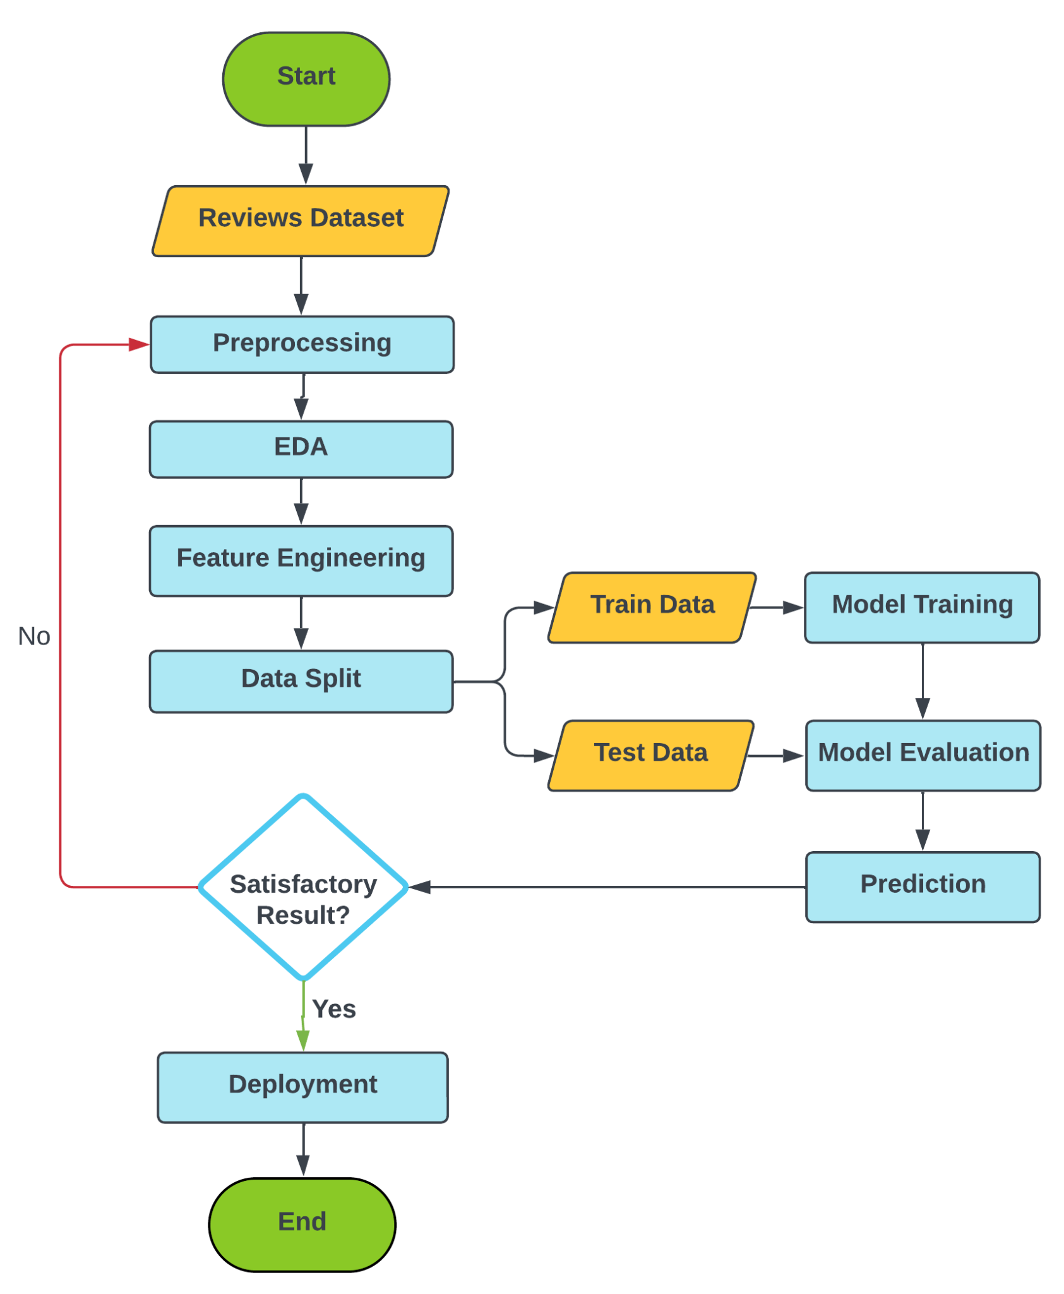
Project Workflow

Slide 4
Dataset Details
Python Libraries/Packages Used
The dataset used in this project is hotel_reviews.xlsx which contains
20491 instances of reviews with two features which are Review and Rating.
NumPy
Pandas
Plotly
Matplotlib
NLTK
SpaCy
Sklearn
Imblearn

Slide 5
Exploratory Data Analysis

Slide 6
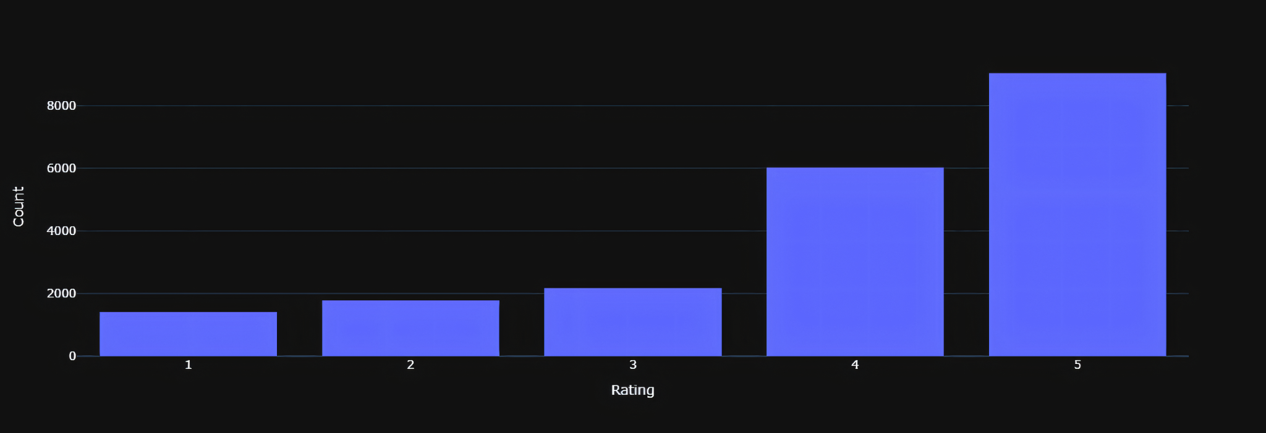
Rating Distribution
ratings = hotel_reviews["Rating"].value_counts()
fig = px.bar(data_frame=ratings, y="count")
fig.update_layout(xaxis_title="Rating", yaxis_title="Count")
fig.show()
Inference-
A large number of customers have given good 4-5 star ratings.
Few number of peoples have given low 1-2 star ratings.
This implies that most of the customers are nearly satisfied with their stay at the hotel.
And a large number of hotels are providing good and useful services to customers.
Few hotels are lacking a little bit in their quality of service.

Slide 7
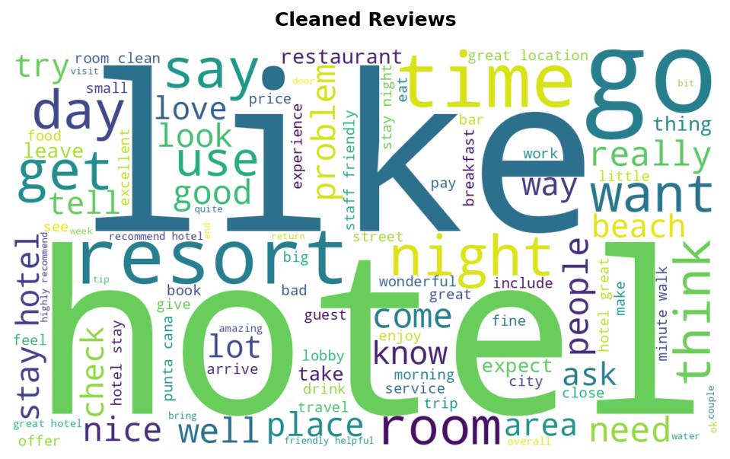
What words stand out in the reviews?
wordcloud = WordCloud(width=1280, height=720,stopwords=stop_words, max_words=100, margin=3,
background_color="white").generate(all_reviews)
plt.figure(dpi=150, figsize=(8,5))
plt.imshow(wordcloud, interpolation='bilinear')
plt.title("Cleaned Reviews", pad=15, weight="bold")
plt.axis("off")
Inference-
From the word cloud it can be concluded that most of the reviews contain positive words, this means most of the reviews about hotels are positive.
So, majority of hotels are of good standards and are providing good and useful services to customers.

Slide 8
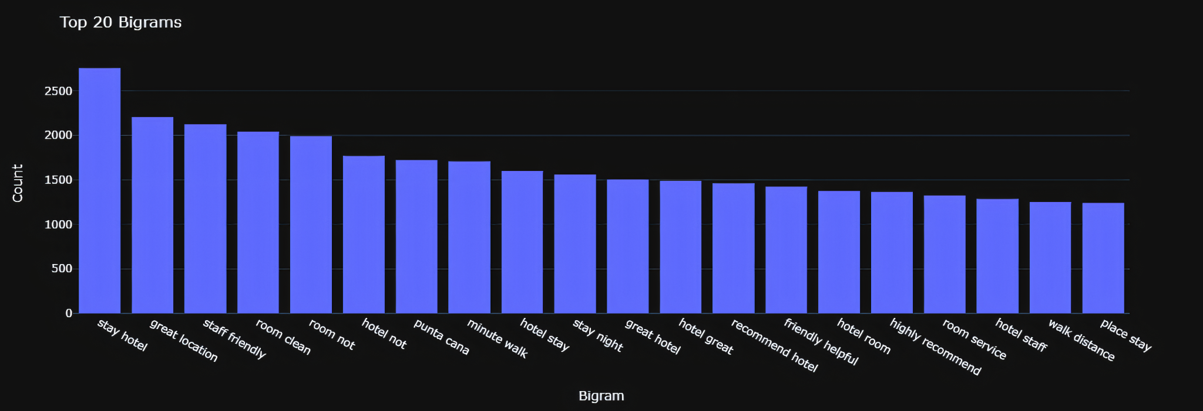
Bi-Grams
bigram_labels, bigram_counts = get_ngrams_frequency(bigrams, top_n)
fig = px.bar(x=bigram_labels, y=bigram_counts)
fig.update_layout(xaxis_title="Bigram", yaxis_title="Count", title=f"Top {top_n} Bigrams")
fig.show()
Inference-
Top frequent bigrams are positive sounding like great location, clean room, etc.

Slide 9
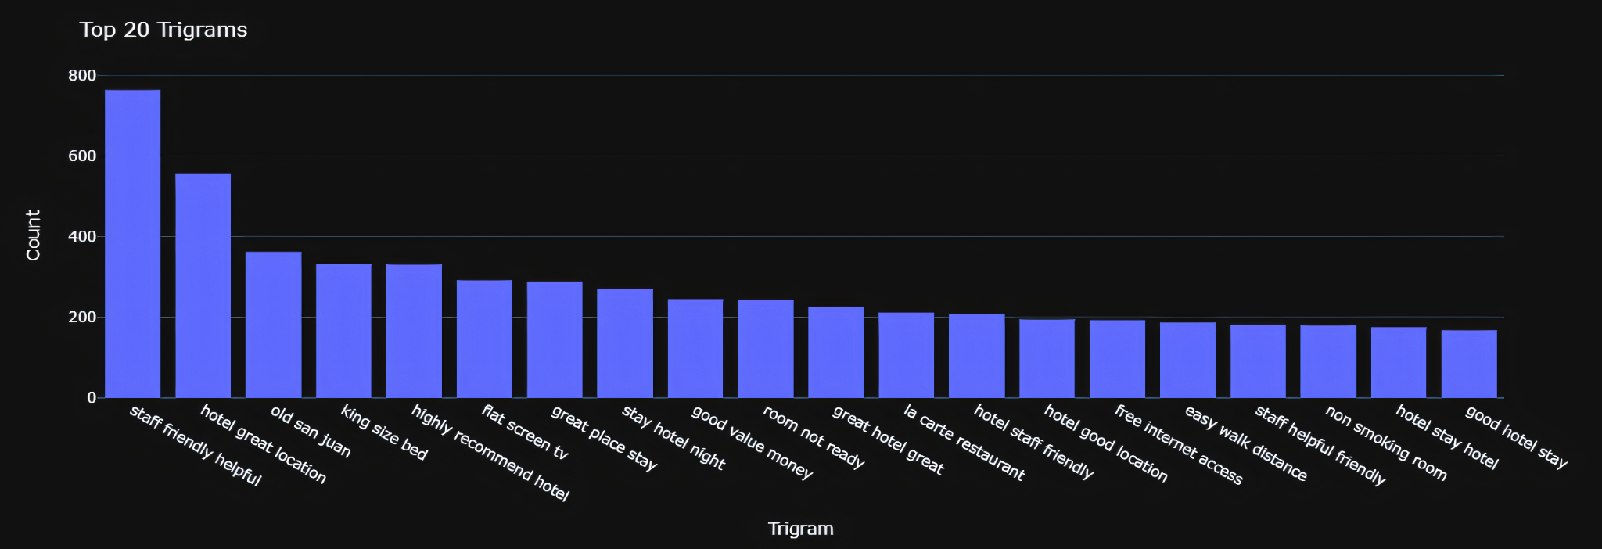
Tri-Grams
trigram_labels, trigram_counts = get_ngrams_frequency(trigrams, top_n)
fig = px.bar(x=trigram_labels, y=trigram_counts)
fig.update_layout(xaxis_title="Trigram", yaxis_title="Count",
title=f"Top {top_n} Trigrams")
fig.show()
Inference-
Top frequent trigrams are positive sounding like staff friendly helpful, highly recommend hotel, flat screen tv, hotel staff friendly, etc.
This means that most of the hotels are of good standard and provide good and useful services to customers. Resulting in most number of happy customers.

Slide 10
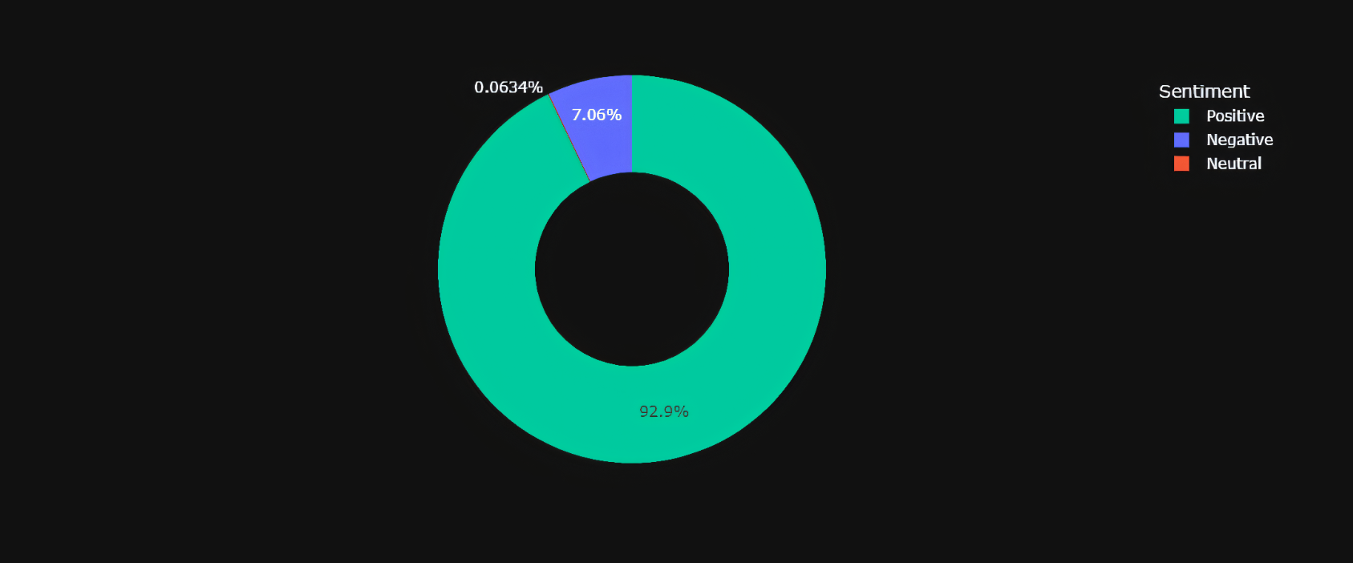
VADER Sentiment Analysis
value_counts = scores_df["Sentiment"].value_counts()
fig = px.pie(names=value_counts.index, values=value_counts.values,
color_discrete_sequence=["#00CC96", "#636EFA", "#EF553B"], hole=0.5)
fig.update_layout(legend={"title": "Sentiment"})
fig.show()
Inference-
As found out earlier from word cloud, bigrams, trigrams, etc., indeed majority of the reviews are positive.
Very few reviews are negative.

Slide 11
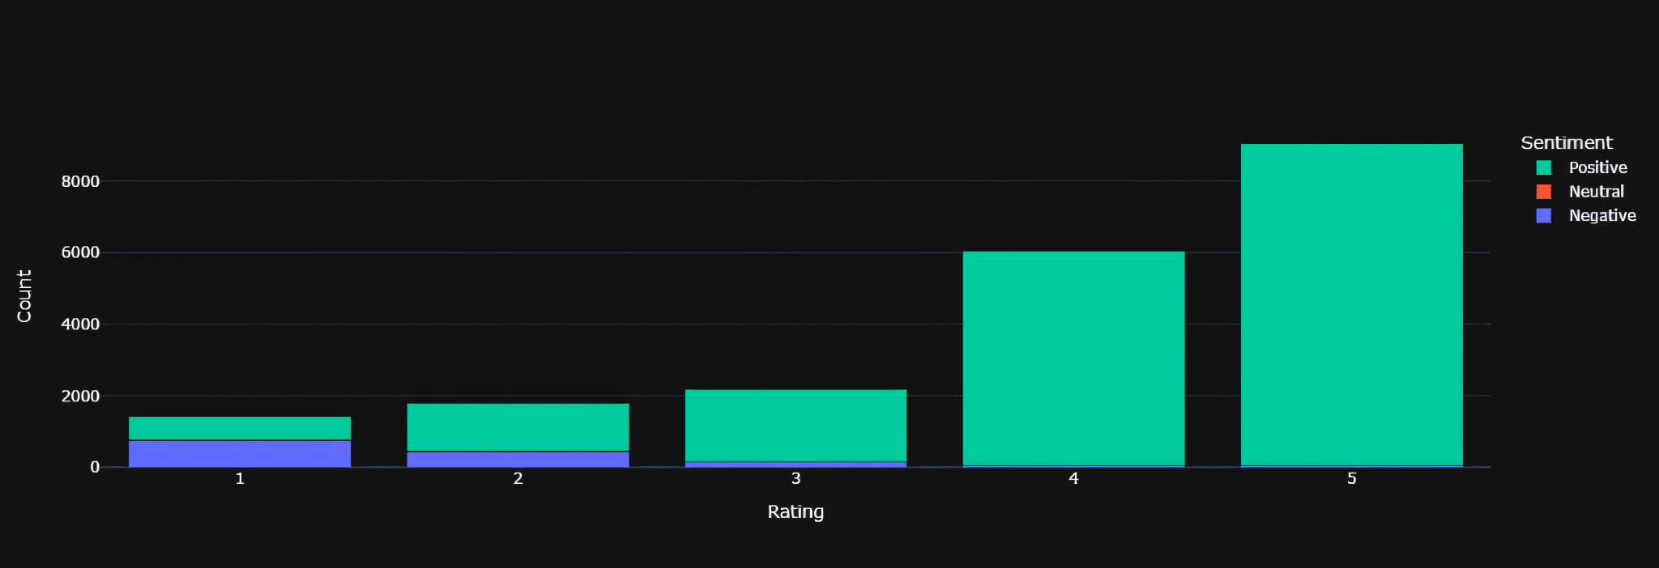
Distribution Of Sentiment By Rating
rating_counts = scores_df.groupby(["Rating", "Sentiment"]).size().unstack().fillna(0)
fig = go.Figure()
for sentiment in rating_counts.columns:
fig.add_trace(go.Bar(name=sentiment, x=rating_counts.index, y=rating_counts[sentiment]))
fig.update_layout(barmode="stack")
fig.update_layout(xaxis_title="Rating", yaxis_title="Count", legend={"title": "Sentiment"})
fig.show()
Inference-
With increase in rating, number of positive reviews also increases.
Majority of negative reviews fall in 1-2 ratings.

Slide 12
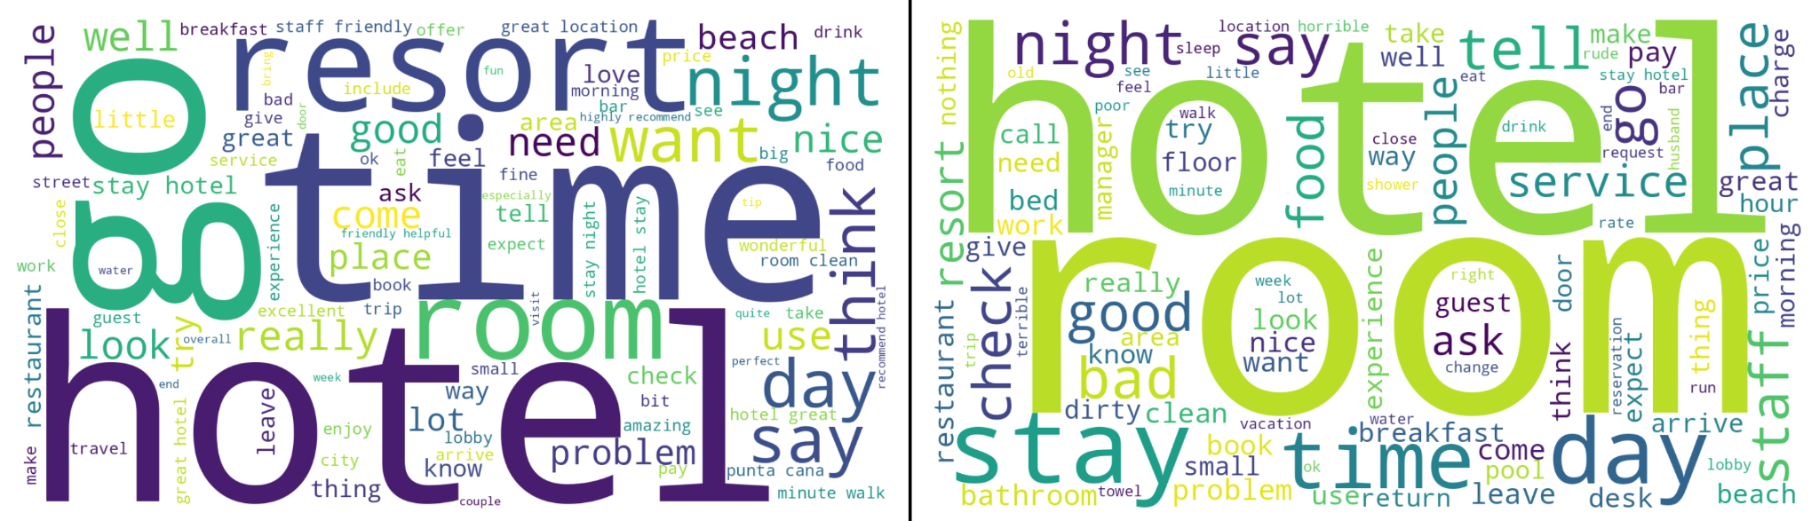
What words stand out for both sentiments?
fig, axs = plt.subplots(nrows=1, ncols=2, figsize=(12,7), dpi=250)
axs[0].imshow(positive_wordcloud, interpolation="bilinear")
axs[0].set_title("Positive Reviews", pad=15, weight="bold")
axs[1].imshow(negative_wordcloud, interpolation="bilinear")
axs[1].set_title("Negative Reviews", pad=15, weight="bold")
line = Line2D([0.5, 0.5], [0.25, 0.75], transform=fig.transFigure, figure=fig, color='black')
fig.lines.extend([line])
plt.tight_layout(pad=2)
Inference-
hotel is the main topic in both positive and negative reviews. And indeed it should be like this.
In negative reviews room is another biggest topic. This indicates that people who wrote negative reviews had faced most of the problems in their rooms.
In negative reviews there are mostly positive sounding words but still there are negative words like bad, rude, problem, dirty, etc., this means some of the hotels are lacking a little bit in providing good and useful services to customers.

Slide 13
Model Building

Slide 14
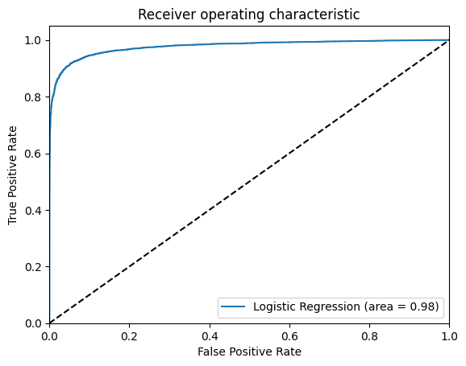
Logistic Regression
Classification Report
 | Precision | Recall | F1 Score | Support
0 | 0.92 | 0.95 | 0.93 | 5793
1 | 0.94 | 0.92 | 0.93 | 5634
Accuracy |  |  | 0.93 | 11427
Macro Avg | 0.93 | 0.93 | 0.93 | 11427
Weighted Avg | 0.93 | 0.93 | 0.93 | 11427
ROC Curve

Slide 15
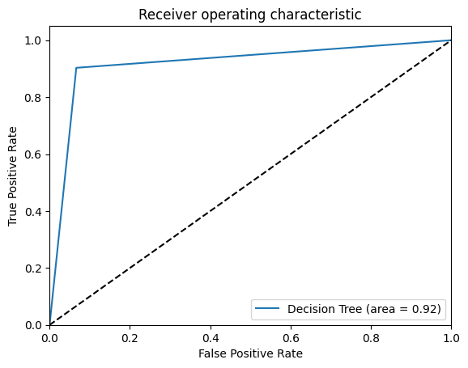
Decision Tree
Classification Report
 | Precision | Recall | F1 Score | Support
0 | 0.91 | 0.93 | 0.92 | 5793
1 | 0.93 | 0.90 | 0.92 | 5634
Accuracy |  |  | 0.92 | 11427
Macro Avg | 0.92 | 0.92 | 0.92 | 11427
Weighted Avg | 0.92 | 0.92 | 0.92 | 11427
ROC Curve

Slide 16
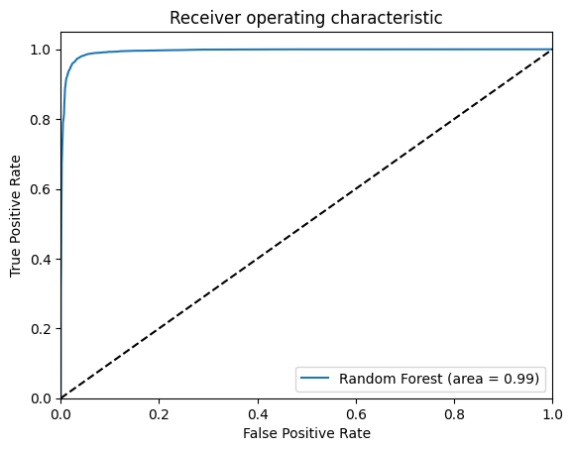
Random Forest
Classification Report
 | Precision | Recall | F1 Score | Support
0 | 0.97 | 0.97 | 0.97 | 5793
1 | 0.97 | 0.97 | 0.97 | 5634
Accuracy |  |  | 0.97 | 11427
Macro Avg | 0.97 | 0.97 | 0.97 | 11427
Weighted Avg | 0.97 | 0.97 | 0.97 | 11427
ROC Curve

Slide 17
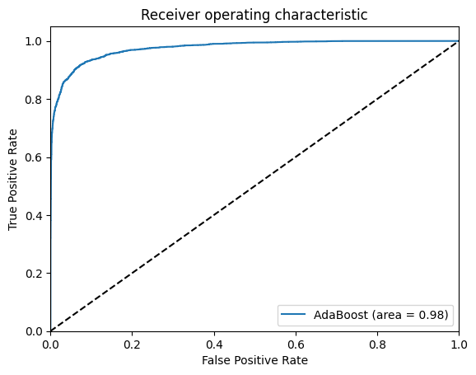
AdaBoost
Classification Report
 | Precision | Recall | F1 Score | Support
0 | 0.92 | 0.92 | 0.92 | 5793
1 | 0.92 | 0.92 | 0.92 | 5634
Accuracy |  |  | 0.92 | 11427
Macro Avg | 0.92 | 0.92 | 0.92 | 11427
Weighted Avg | 0.92 | 0.92 | 0.92 | 11427
ROC Curve

Slide 18
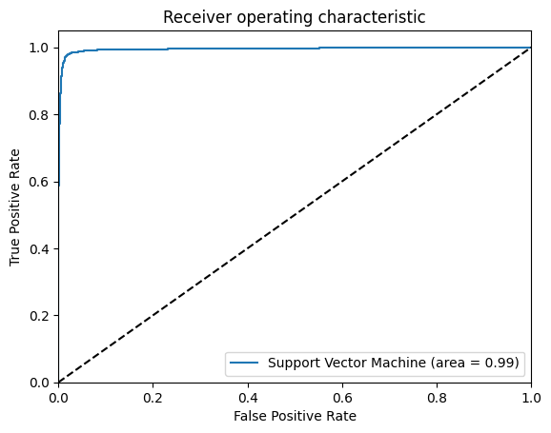
Support Vector Machine
Classification Report
 | Precision | Recall | F1 Score | Support
0 | 0.97 | 0.99 | 0.98 | 5793
1 | 0.99 | 0.97 | 0.98 | 5634
Accuracy |  |  | 0.98 | 11427
Macro Avg | 0.98 | 0.98 | 0.98 | 11427
Weighted Avg | 0.98 | 0.98 | 0.98 | 11427
ROC Curve

Slide 19
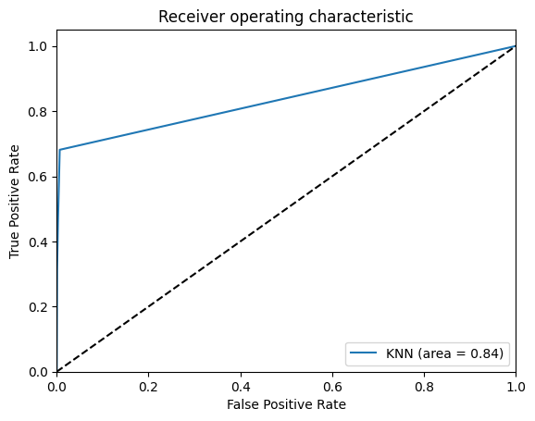
KNN
Classification Report
 | Precision | Recall | F1 Score | Support
0 | 0.66 | 1.00 | 0.79 | 5793
1 | 0.99 | 0.47 | 0.64 | 5634
Accuracy |  |  | 0.74 | 11427
Macro Avg | 0.83 | 0.73 | 0.72 | 11427
Weighted Avg | 0.82 | 0.74 | 0.72 | 11427
ROC Curve

Slide 20
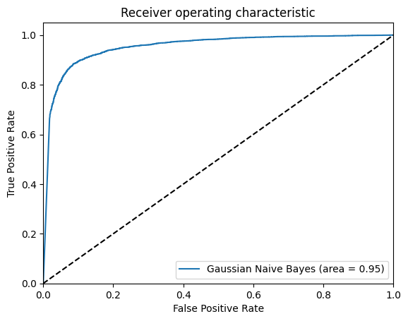
Gaussian Naive Bayes
Classification Report
 | Precision | Recall | F1 Score | Support
0 | 0.89 | 0.92 | 0.90 | 5793
1 | 0.91 | 0.88 | 0.90 | 5634
Accuracy |  |  | 0.90 | 11427
Macro Avg | 0.90 | 0.90 | 0.90 | 11427
Weighted Avg | 0.90 | 0.90 | 0.90 | 11427
ROC Curve

Slide 21
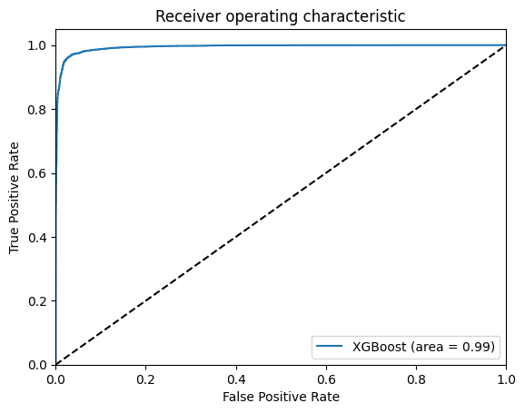
XGBoost
Classification Report
 | Precision | Recall | F1 Score | Support
0 | 0.96 | 0.97 | 0.97 | 5793
1 | 0.97 | 0.96 | 0.97 | 5634
Accuracy |  |  | 0.97 | 11427
Macro Avg | 0.97 | 0.97 | 0.97 | 11427
Weighted Avg | 0.97 | 0.97 | 0.97 | 11427
ROC Curve

Slide 22
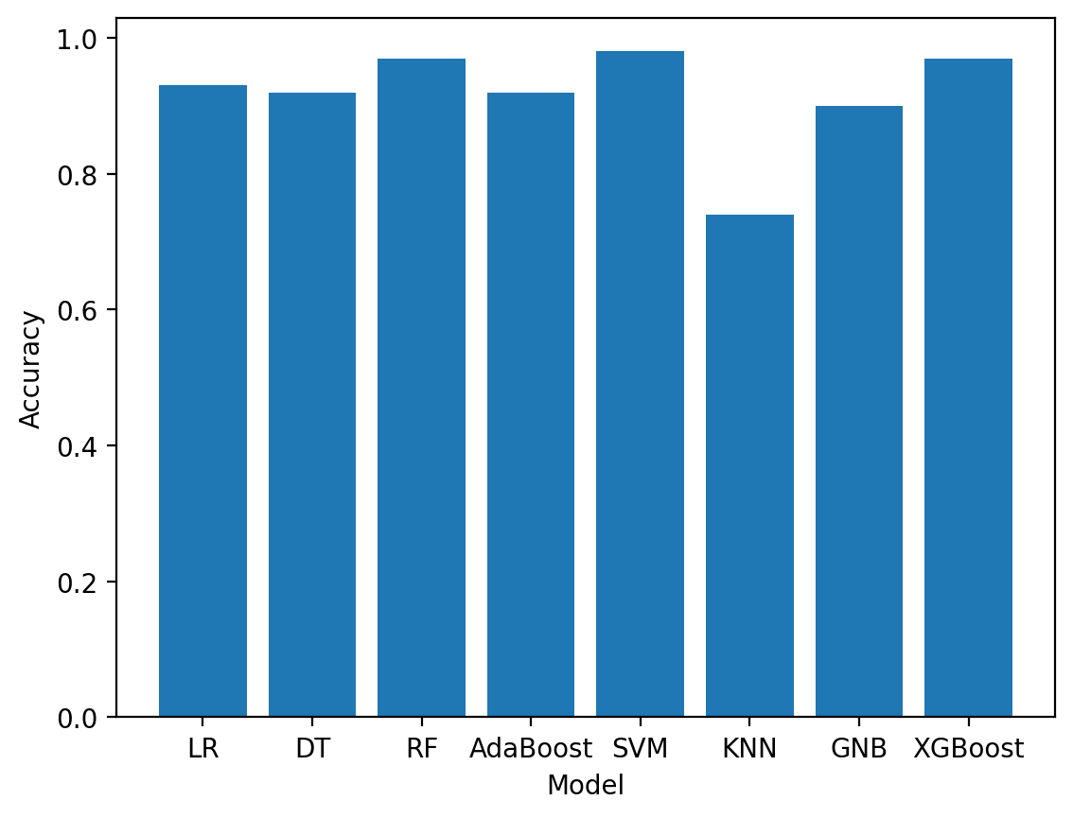
Model Result
Many models achieve nearly 100% accuracy, but suffer from overfitting, rendering them impractical. Logistic regression emerged as the most effective for generalizing across varying text lengths, outperforming others in testing.

Slide 23
Deployment

Slide 24
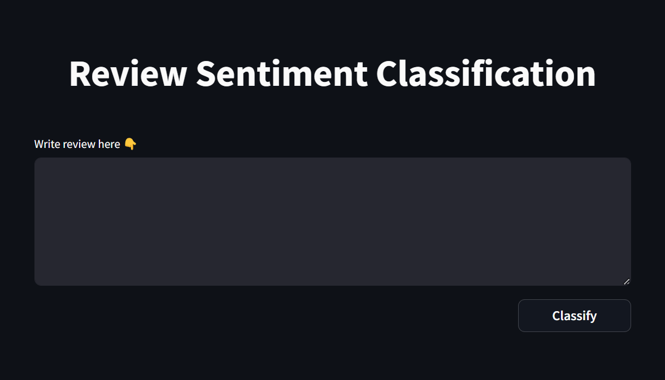
Tech Stack & UI Overview
Tech Stack-
Python
Streamlit
Streamlit Community Cloud
Web address for deployment - Review Sentiment Classification
UI Design-

Slide 25
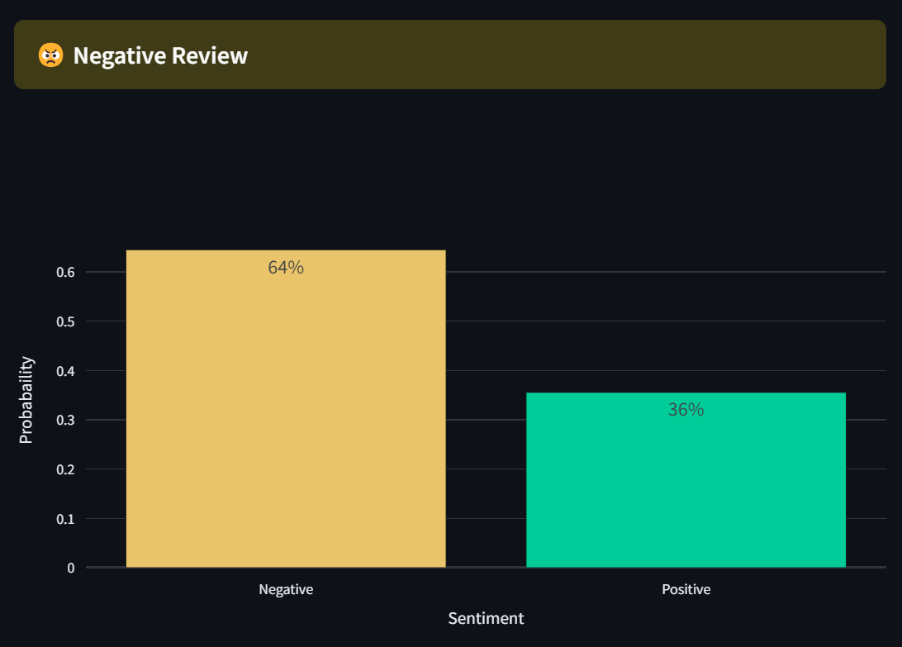
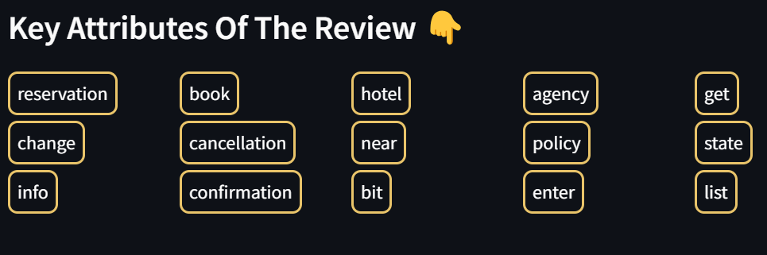
How It Works?
Our deployment predicts whether a review is positive or negative based on calculated probabilities. It assigns the label corresponding to the higher probability among the classes.
It identifies key review keywords by comparing the review's words with the embedding function's vocabulary, displaying them accordingly.

Slide 26
● Data Preprocessing
● Model Selection
Project Challenges:
Key Areas

Slide 27
Data Preprocessing
Model Selection
Problem
Noisy text data, wrong spellings, sentences lacking semantic meaning.
Solution
Implementing robust preprocessing techniques like tokenization, spelling correction, lemmatization, to clean data effectively.
Problem
Selecting the right classification model posed difficulties. While some models tended to overfit, others lacked the ability to generalize across varying lengths of text.
Solution
After extensive experimentation and evaluation, we discovered logistic regression as the optimal model for our task, balancing performance with computational resources.

Slide 28
Thank You!

